Slide 1
Drug Classification
Mousta Taenchiki and Simran Soin

Slide 2
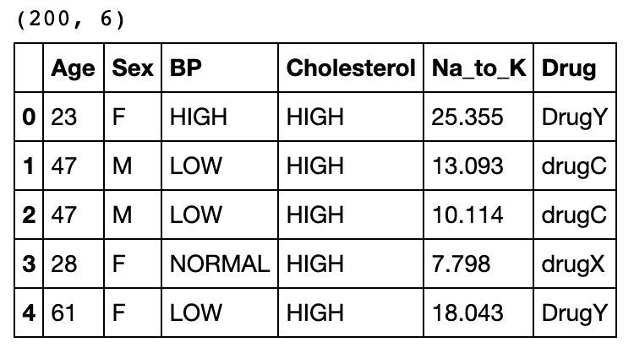
Introduction to Dataset
5 independent variables
Age, Sex, BP, Cholesterol, Sodium to Potassium ratio
Target Feature: Drug type
Five classifications
drugA, drugB, drugC, drugx, DrugY
200 sample patients in dataset

Slide 3
Unsupervised Analysis
Visualized each of the independent variables against the target feature in univariate graphs
Created histograms to see the distribution within an independent variable
KMeans clustering algorithms to determine which features were most influential
Age and Sodium/Potassium ratio

Slide 4
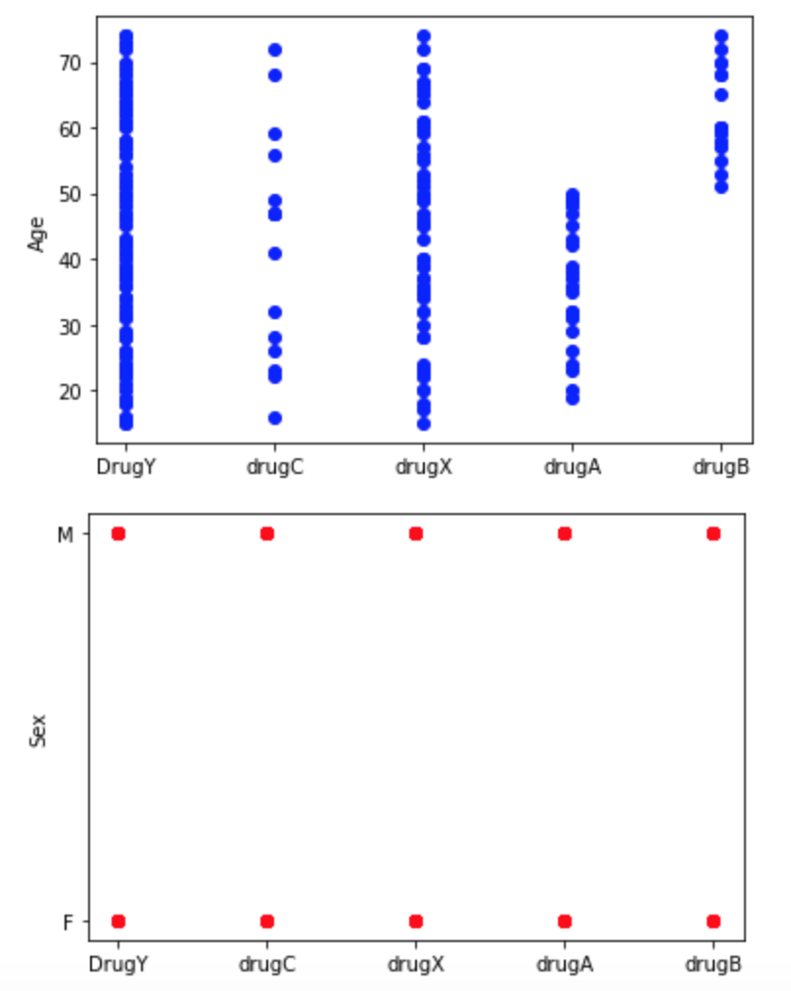
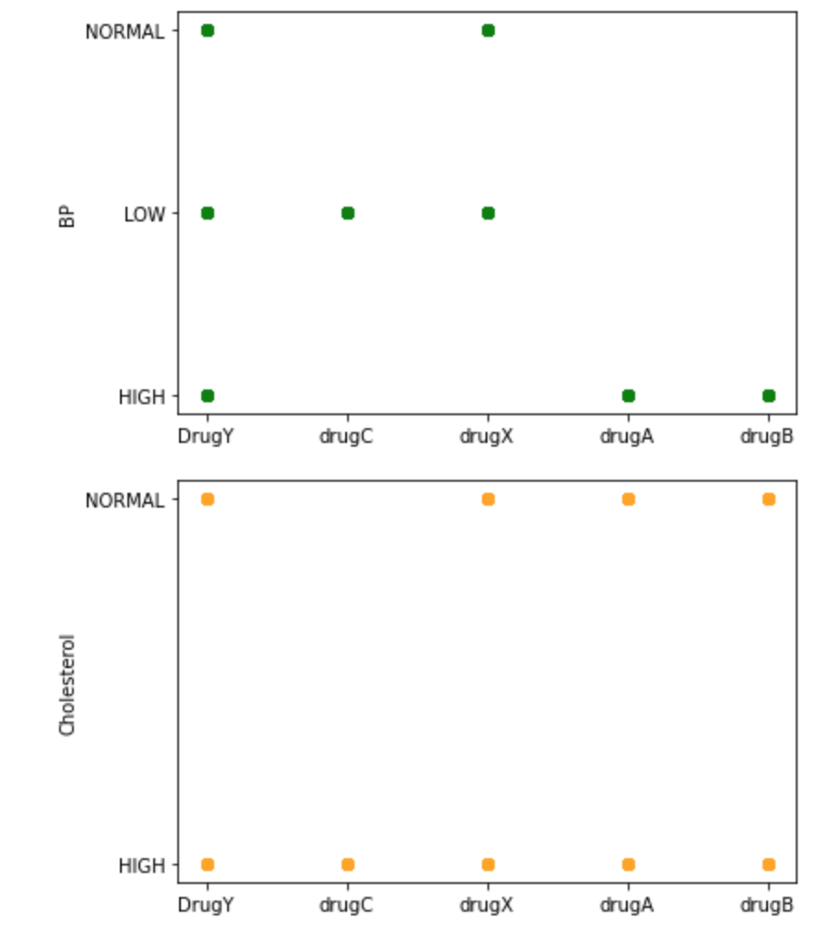
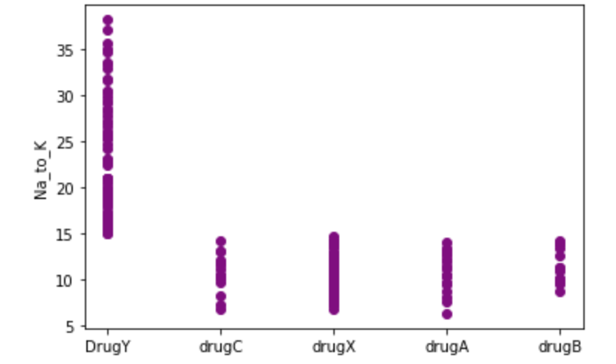

Slide 5
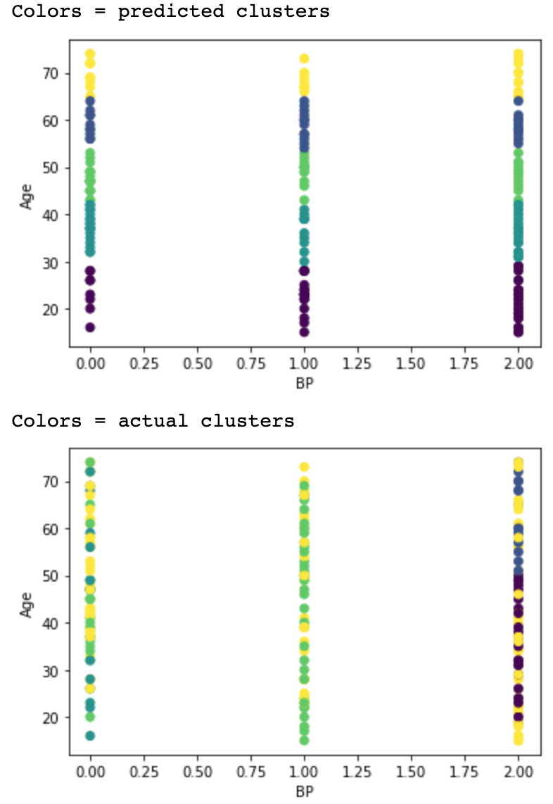
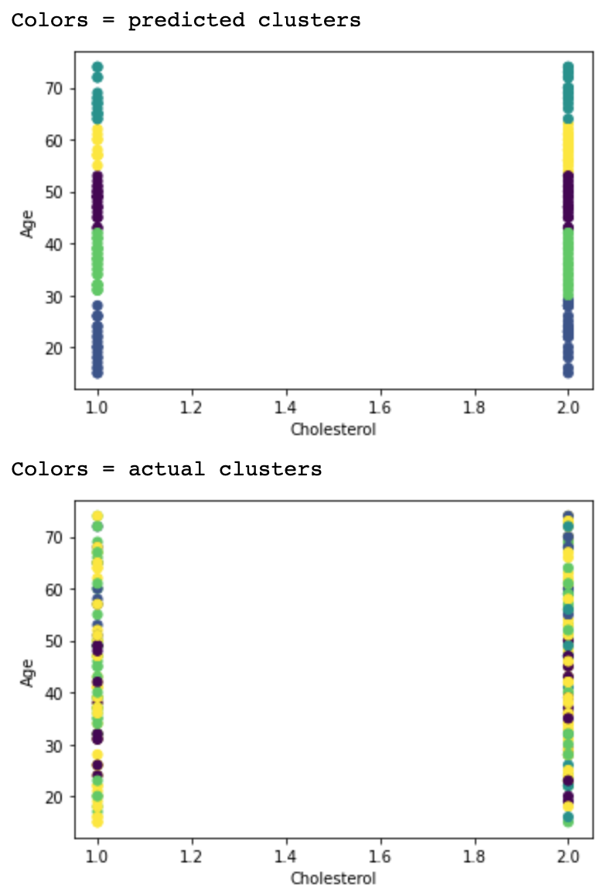
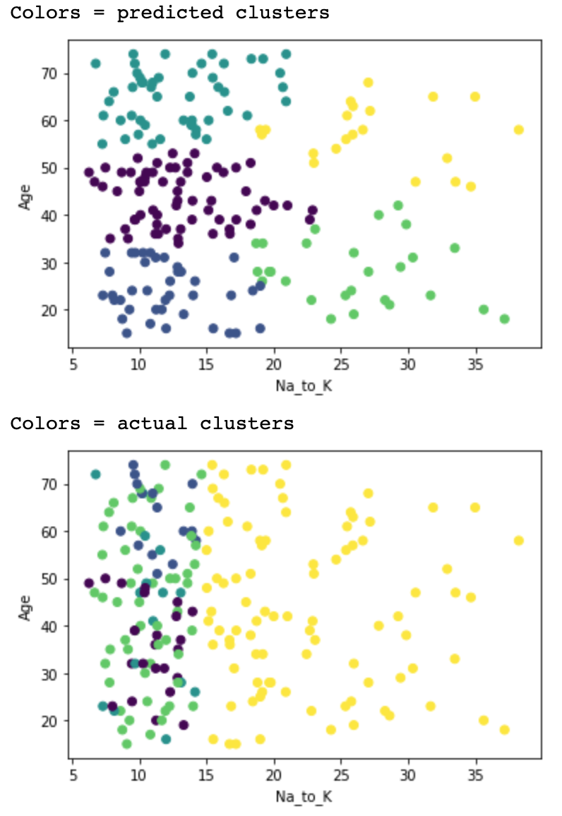

Slide 6
Supervised Analysis
Logistic Regression
Lasso Regularization
Ridge Regularization
Polynomial Feature Transformation
SVMs
Linear Kernel
Radial Basis Function Kernel
Polynomial Kernel
Neural Networks

Slide 7
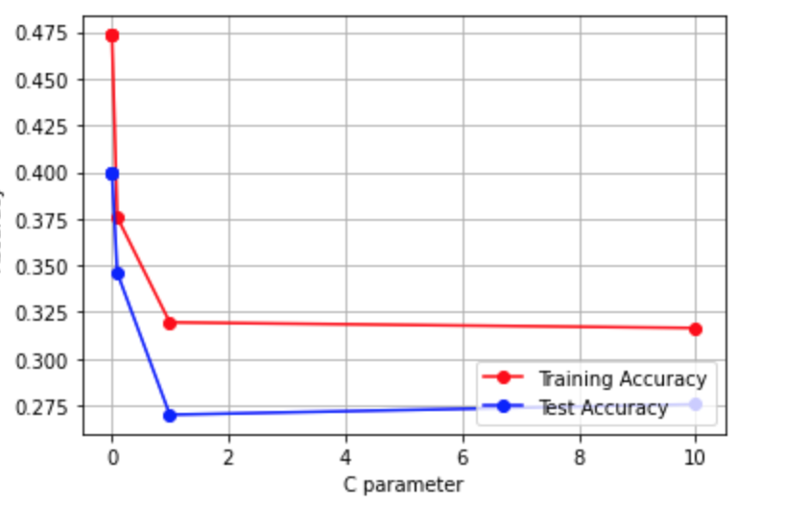
Logistic Regression
Low accuracies for all regularization/transformation techniques attempted
Ridge, Lasso, Polynomial Feature transformation
High bias and underfitting dataset
Example graph from Lasso Regularization model (other models produced graphs fairly similar to this)

Slide 8
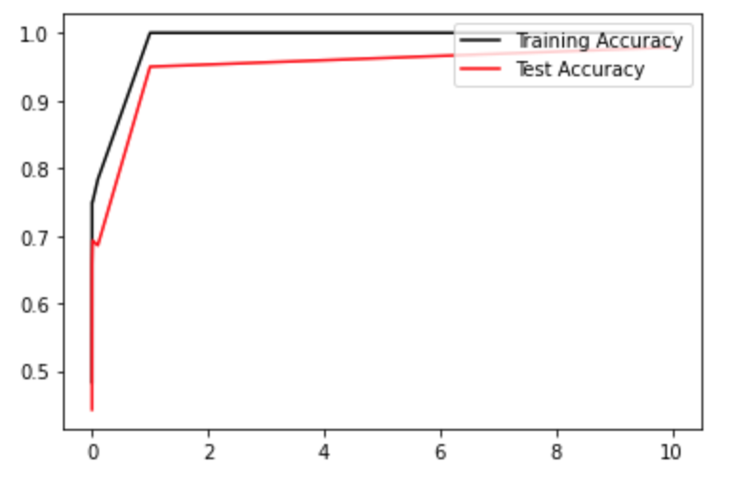
SVMs
Highest accuracy given using a linear kernel
Linear kernel SVM's and RBF SVM's gave higher accuracies as c values increased
No change in accuracy for all c values of SVM's using a polynomial kernel
Margin is most likely small, indicating that the model is overfitting
Graph for SVM's using a linear kernel

Slide 9
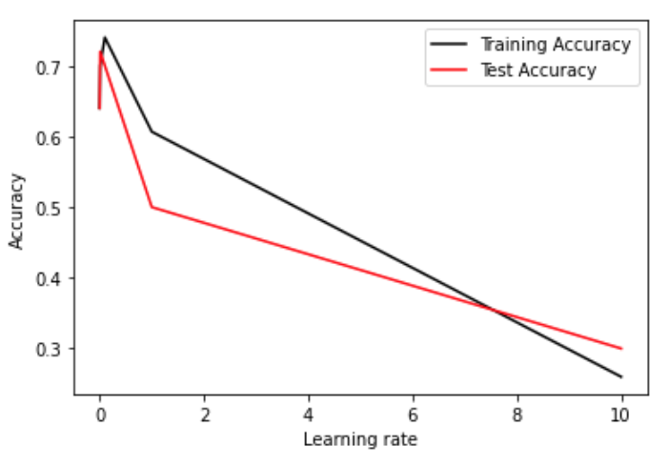
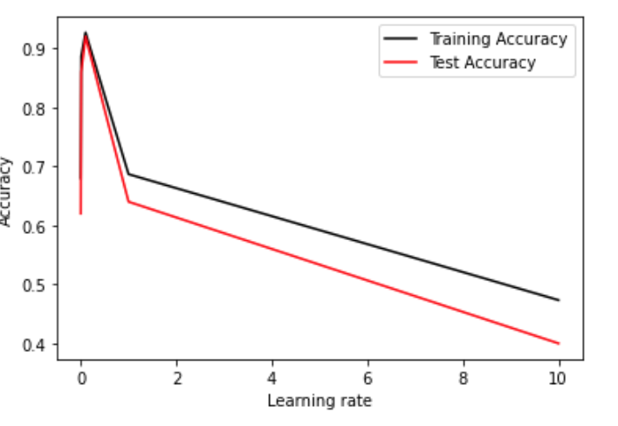
Neural Networks
Yielded the highest accuracy out of all models
Even when λ=10, training accuracy is still 92% and testing accuracy is 74%
This isn't likely to hold true with greater populations
Likely overfitting
1 hidden layer
2 hidden layers
Notes:
activation = ReLU

Slide 10
Concluding Thoughts
Logistic Regression underfitting --> perhaps not the best model choice
Neural Network was likely overfitting due to small dataset
SVM less likely to overfit than neural networks
Linear Kernel most accurate
One thing to consider: eliminating independent variables

